Slide 1
Getting Started with Medical Data Analysis in Python
Notes:
CLICE 1 <In this video, we introduce some simple Pandas methods that all data scientists and analysts should know when using Python, Pandas and data. At this point, we assume that the data has been loaded. It's time for us to explore the dataset. >

Slide 2
Basic insights from the data
Understand your data before you begin any analysis
Should check:
Data Types
Data Distribution
Locate potential issues with the data
Notes:
CLICE 1 <Pandas has several built-in methods that can be used to understand the data type or features or to look at the data distribution within the dataset.
Using these methods gives an overview of the dataset and points out potential issues, such as the wrong data type of features, which may need to be resolved later.>

Slide 3
Question
What data type do you expect in the Age column?
object
int64
datetime64
Notes:
CLICE 1 <Question
CLICE 2< What data type do you expect in the Age column?
object
int64
datetime64>

Slide 4
Basic Insights of Dataset - Data Types
>
Pandas Type | Native Python Type | Description
object | string | numbers and strings
int64 | int | Numeric characters
float64 | float | Numeric characters with decimals
datetime64, timedelta[ns] | N/A (but see the datetime module in Python's standard library) | time data.
Why check data types?
potential info and type mismatch
compatibility with python methods
Notes:
CLICE 1 <Data has various types. The main types stored in Pandas' objects are object, float, Int, and datetime. The data type names are somewhat different from those in native Python. >
CLICE 2 <This table shows the differences and similarities between them. Some are very similar such as the numeric data types int and float. The object pandas type function's identical to the string in Python, save for the name change. While the DateTime Pandas type is beneficial for handling time series data. >

Slide 5
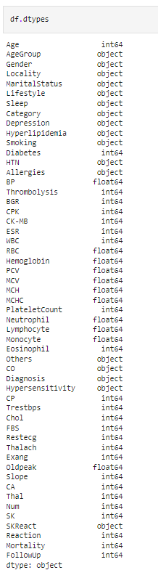
Basic Insights of Dataset - Data Types
In pandas, we use dataframe.dtypes to check data types
Notes:
CLICE 1 <After reading data into the Pandas dataframe, we must explore the dataset.
There are several ways to obtain essential insights into the data to help us better understand our dataset.>
CLICE 2 <Data has a variety of types.
The main types stored in Pandas dataframes are object, float, int, bool and datetime64. To better learn about each attribute, it is always good for us to know the data type of each column.
As shown above, it is clear to see that the data type of "Age" and "Diabetes" is int64, "Gender" and "Locality" are objects, and "BP", "RBC", and "Hemoglobin" are float64, etc.
These data types can be changed. For example, we have some fields like "Lifestyle", "Sleep", and "Depression", which are objects instead of bool. We will learn how to fix it in a later module.>

Slide 6
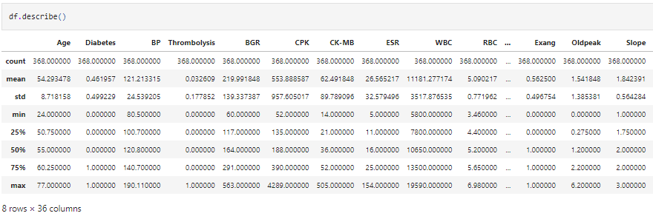
dataframe.describe()
• Returns a statistical summary
df.describe ()
Notes:
CLICE 1 <Now, we would like to check the statistical summary of each column to learn about the distribution of data in each column.
Statistics can tell the data scientist if they are mathematical problems that may exist, such
as outliers and large deviations.>
CLICE 2 <If we would like to get a statistical summary of each column, e.g. count, column mean value, standard column deviation, etc., we use the described method:
This method will provide various summary statistics, excluding NaN (Not a Number) values.>
CLICE 3 <By default, the dataframe.describe function skips rows and columns that do not contain numbers. It can be done by the description method, which also works for object-type columns. To enable collating all columns, we could add an argument. Include is equal to everything in the parentheses of the function description. The result now shows all 36 columns, including object type attributes.>

Slide 7
Question
How would you generate descriptive statistics for all the columns for the dataframe df?
df.describe( )
df.describe(include = "all")
df.info
Notes:
CLICE 1 <Question
CLICE 2 <How would you generate descriptive statistics for all the columns for the dataframe df?
df.describe( )
df.describe(include = "all")
df.info

Slide 8
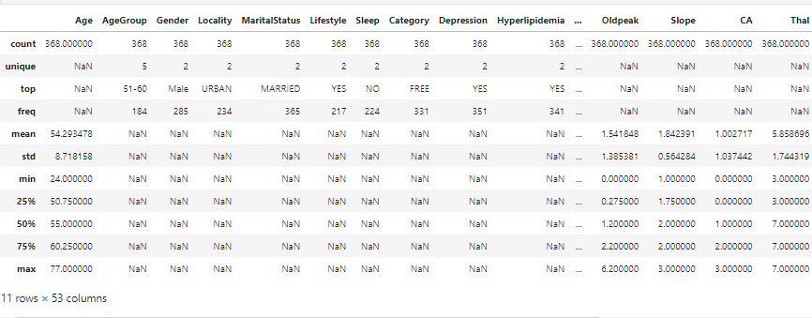
dataframe.describe(include="all")
Provides full summary statistics
df.describe (include="all")
Notes:
<This shows the statistical summary of all numeric-typed (int, float) columns.
For example, the attribute "BP" (blood pressure) has 368 counts, the mean value of this column is 121.21, and the standard deviation is 24.54, the minimum value is 80.5, the 25th percentile is 100.7, the 50th percentile is 120.8, the 75th percentile is 140.7, and the maximum value is 109.11.
However, what if we also want to check all the columns, including those of type objects?
You can add an argument with = "all" inside the bracket. Let's try it again.>

Slide 9
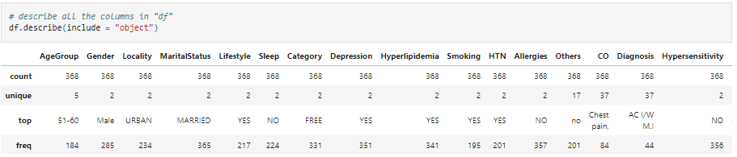
Display unique values
Notes:
CLICE 1 <Now, it provides the statistical summary of all the columns, including object-typed attributes.
We can now see how many unique values there are: the top value and the frequency of the maximum value in the object-typed columns.
Some values in the table above show as "NaN". This is because those numbers are not available regarding a particular column type.
Let's see what values are available for object-typed columns>

Slide 10
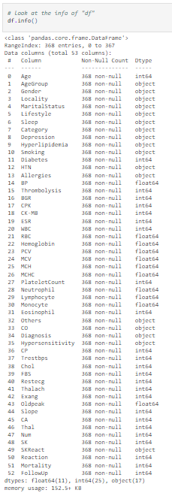
Basic Insights of Dataset - Info
datdataframe.info () provides a concise summary of our DataFrame.
df.info ()
Row number
Notes:
CLICE 1 <Another method you can use to check your dataset is: Info. It provides a concise summary of your data frame. This method prints information about a data frame, including the index dtype and columns, non-null values and memory usage.
The info() method does not return any value. It prints the information.>

Slide 11

IBM Developer
Notes:
CLICE 1 <You just saw the steps needed to create a DataFrame, and then export that DataFrame to a CSV file. You may face an opposite scenario in which you must import a CSV into Python. If that’s the case, you can check out this course that explains how to import a CSV file into Python using Pandas.
You may also want to check the Pandas Documentation for further information about using ‘to_csv’.>

